Slide 1
UNIT 6: GAME DEVELOPMENT TOOLS, FUNCTIONS, AND PROPERTIES

Slide 2
UNIT DESCRIPTION
Activities in this unit of study are constructed to facilitate the design, development, and analysis of existing tools used for game development. This unit will explore software selection, language selection, and technical tools used in the creation of interactive applications and video games.

Slide 3
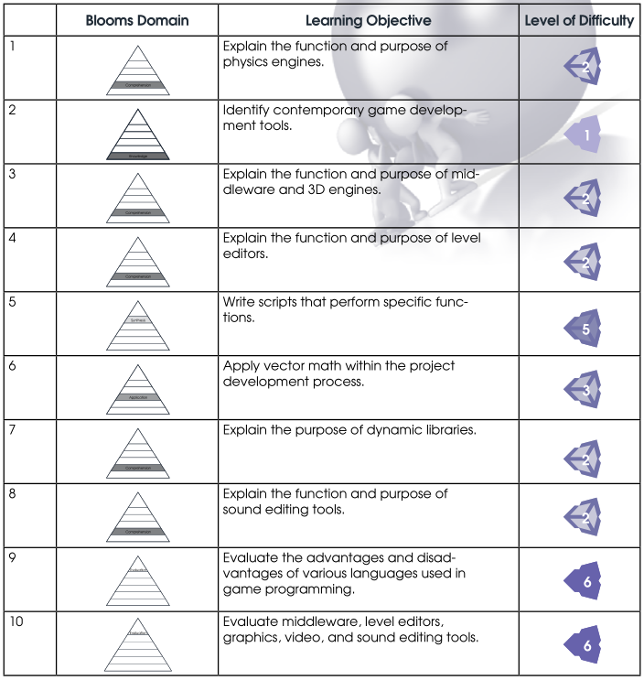
LEARNING OBJECTIVES
By the end of this unit, learners should be able to perform the following tasks:

Slide 4
COURSE OUTLINE

Slide 5


1. Gaming Engines
a. What is a game engine?
b. Middleware
c. 3D engines
Notes:
a rendering engine ("renderer") for 2D or 3D graphics, a physics engine or collision detection (and collision response), sound, scripting, animation, artificial intelligence, networking, streaming, memory management, threading, localization support, scene graph, and may include video support for cinematics.
AI.implant – from Presagis, an AI authoring and runtime engine
AiLive - a suite of game AI middleware
Autodesk Gameware - from Autodesk, includes Scaleform GFx, Kynapse, Beast and HumanIK
Euphoria - 3D human animation engine created by NaturalMotion based on Dynamic Motion Synthesis
SpeedTree - vegetation programming and modelling software products
Havok - 3D physics engine
Nvidia GameWorks - visual FX, physics, particle and fluid simulations
Bink Video - video file format, video compression tools and playback library from RAD Game Tools.
Umbra 3 - solution for visibility and occlusion culling
Wwise - audio engine and authoring tools from Audiokinetic.

Slide 6















Slide 7
2. Resource development tools
a. Graphic file formats and editors
b. Video file formats and editors
c. Sound file formats and editors
d. Asset file formats

Slide 8
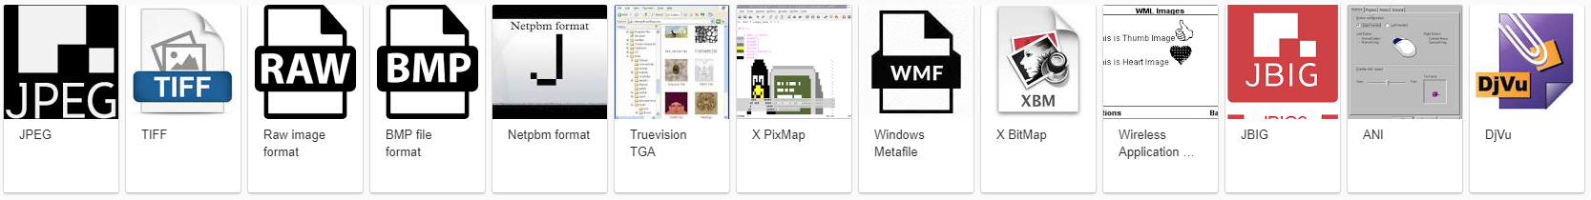



Slide 9

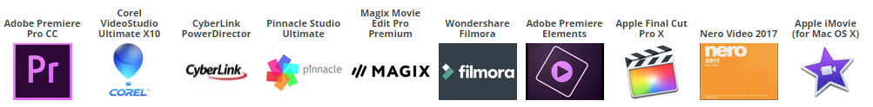

Slide 10

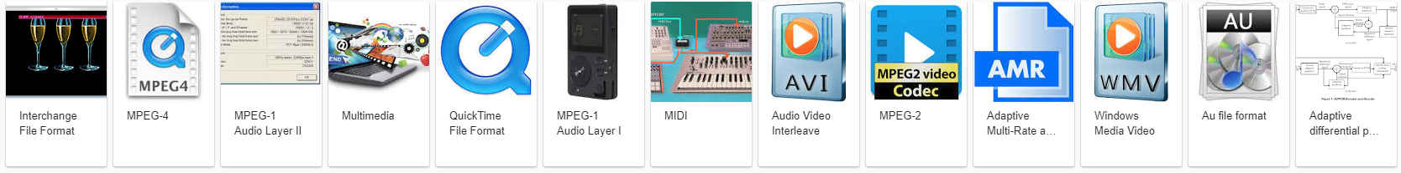

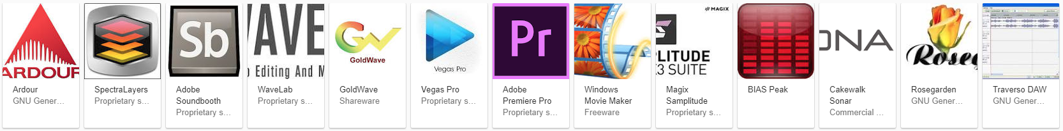

Slide 11
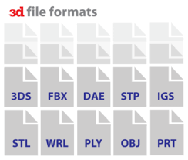
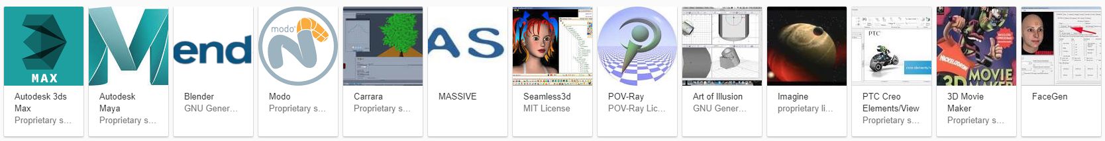

Slide 12
3. Level Editors
a. Function and purpose
b. In-game level editors
c. Popular level editors
Notes:
A level editor (also known as a map, campaign or scenario editor) is software used to design levels, maps, campaigns, etc. and virtual worlds for a video game.
In some cases, the creator of a video game releases an official level editor for the game, but other times the community of fans step in to fill the void. The level editor can be integrated into the game; for example, a track editor for a racing game. Other times (and most often), the editor is a separate application, as are most fan-released level editors.
A level editor is often limited to creating levels for only a certain game engine. Developing a level editor takes a lot of time and it is more time and cost efficient to release multiple games using the same engine instead of developing a new engine and level editor for each game. Level editors offer some limited scope of content creation, but in the case of gaming industry solutions the scope is very large allowing an entire game to be created without the need for much support from a programming team. To make larger changes to a game than simply adding new levels, a software development kit (SDK) is sometimes needed.
https://en.wikipedia.org/wiki/List_of_level_editors

Slide 13
4. Physics Engines
a. Collision detection
b. Dynamic simulation: rigid body and soft-body
Notes:
A physics engine is computer software that provides an approximate simulation of certain physical systems, such as rigid body dynamics (including collision detection), soft body dynamics, and fluid dynamics, of use in the domains of computer graphics, video games and film. Their main uses are in video games (typically as middleware), in which case the simulations are in real-time. The term is sometimes used more generally to describe any software system for simulating physical phenomena, such as high-performance scientific simulation.
https://youtu.be/RWcE6XKdTzc?t=3m42s
https://youtu.be/RWcE6XKdTzc?t=6m21s
https://www.youtube.com/watch?v=fXR5PH4Xu1E

Slide 14
5. Libraries
a. What is a software library: Purpose and examples
b. Dynamic versus Static
Notes:
A library is also a collection of implementations of behavior, written in terms of a language, that has a well-defined interface by which the behavior is invoked. For instance, people who want to write a higher level program can use a library to make system calls instead of implementing those system calls over and over again. In addition, the behavior is provided for reuse by multiple independent programs. A program invokes the library-provided behavior via a mechanism of the language. For example, in a simple imperative language such as C, the behavior in a library is invoked by using C's normal function-call. What distinguishes the call as being to a library function, versus being to another function in the same program, is the way that the code is organized in the system.
Static Linking is the technique of linking the libraries with the main program while creating the executable of the program.
Dynamic Linking is the technique of linking the libraries with the main program during run-time of the program.

Slide 15
Exploring the Unity Editor
Within this unit, learners will gain a deeper understanding of development tools, engines, and level design concepts. They should also continue to develop basic scripting skills required to build any game, and their Capstone Project. The tutorials listed below provide additional hands-on learning experiences with the Unity Editor. They also provide skills that can be retroactively applied to the work already completed. Provide adequate time for learners to complete these tutorials as they cover key scripting topics.

Slide 16
Exploring the Unity Editor
Activating Game Objects: http://unity3d.com/learn/tutorials/modules/scripting/activating-gameobjects
Scope and Access Modifiers: http://unity3d.com/learn/tutorials/modules/beginner/scripting/variable-scope-and-access-modifiers
Awake and Start: http://unity3d.com/learn/tutorials/modules/beginner/scripting/awake-and-start
Update and FixedUpdate: http://unity3d.com/learn/tutorials/modules/beginner/scripting/update-and-fixedupdate
Enabling and Disabling Components: http://unity3d.com/learn/tutorials/modules/beginner/scripting/enabling-disabling-components

Slide 17
Exploring the Unity Editor
6. Translate and Rotate: http://unity3d.com/learn/tutorials/modules/beginner/scripting/translate-and-rotate
7. Look At: http://unity3d.com/learn/tutorials/modules/beginner/scripting/look-at
8. GetButton and GetKey: http://unity3d.com/learn/tutorials/modules/beginner/scripting/get-button-and-get-key
9. Get Axis: http://unity3d.com/learn/tutorials/modules/beginner/scripting/get-axis
10. OnMouseDown: http://unity3d.com/learn/tutorials/modules/beginner/scripting/on-mouse-down
11. GetComponent: http://unity3d.com/learn/tutorials/modules/beginner/scripting/getcomponent

Slide 18
Game Design Document (GDD) Entry
In your Game Design Document (GDD), begin to list the task you will need to address as you
develop your game, using Unity as your game editor and game engine.
• What types of libraries might you need?
• What external file formats might you use?
• Will your game have physics based interactions and, if so, are there any special needs you must take into account?
• Given that Unity supports multiple languages, which language will you use?
Make notes for yourself as to why you made these choices. This will help spark your memory at a later time.

Slide 19
Game Design Document (GDD)
Begin to draft sections 2.1 and 2.2 of your Game Design Document (GDD). At this time, focus most of your attention on gameplay. You will need to consider the physics aspects of the interactions that will occur in your game and depict these in a Game Design Matrix. Things to consider include, but are not limited to: gravity, motion, elasticity, light, and sound.

Slide 20
Other Activities - 1
Watch: https://unity3d.com/learn/tutorials/modules/beginner/2d/physics2d as an introduction to game physics. Then complete this bouncing ball tutorial to understand how physics works in a gaming environment: http://unity3d.com/learn/tutorials/modules/beginner/physics/assignments/bouncing-ball
Complete the Physics Best Practices Tutorial found at: http://unity3d.com/learn/tutorials/modules/intermediate/physics/physics-best-practices

Slide 21
Weekly Assignment
Design a game similar to Angry Birds. (For example – explore monkeys with slingshots that need to shoot coconuts out of trees.) Your game must incorporate Newton’s Three Laws of Motion and his Law of Universal Gravitation. Remember you must account for vertical acceleration and horizontal velocity, as well as distance traveled, and the effect of gravity. (For this game you may ignore friction due to air resistance).

